Slide 1
Generative Adversarial Networks. Cycle GAN
Radu Ionescu Bogdan Alexe
raducu.ionescu@gmail.com bogdan.alexe@fmi.unibuc.ro
Faculty of Mathematics and Computer Science
University of Bucharest

Slide 2
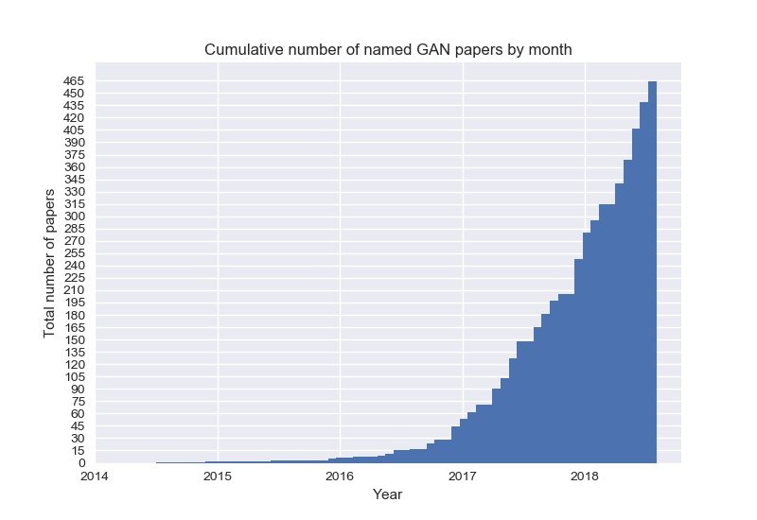
Generative Adversarial Network (GAN)
https://github.com/hindupuravinash/the-gan-zoo

Slide 3

Generative Adversarial Network (GAN)

Slide 4
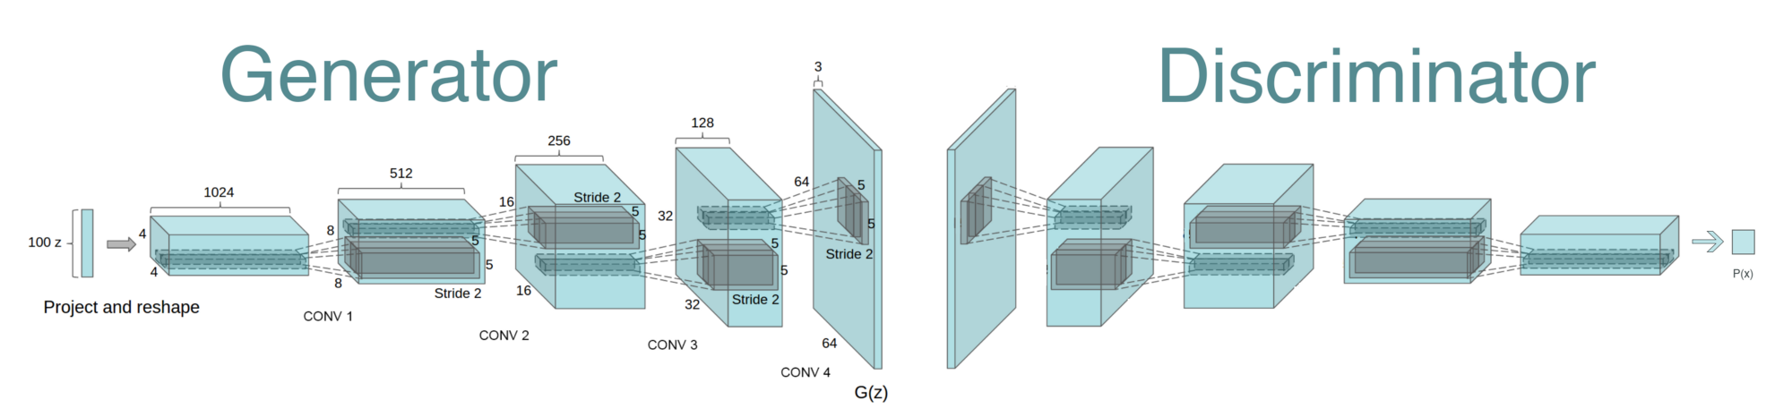
Generative Adversarial Network (GAN)
Binary Classifier:
Conv, Leaky ReLU,
FC, Sigmoid
New components:
Transposed convolution,
Batch Normalization
https://github.com/PramodShenoy/GANerations

Slide 5
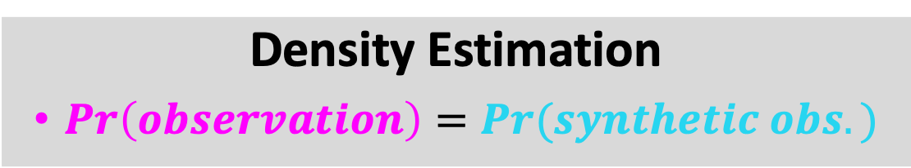
Probabilistic Generative Models
Real world
observations
=
goal of modeling
Model
synthetic
observations
Density Estimation
$Pr\left(observation\right)=Pr(synthetic obs.)$

Slide 6
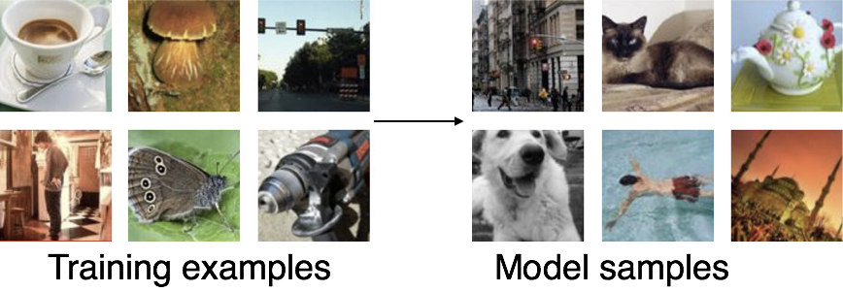
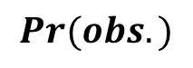
Synthesizing Examples From Probabilistic Generative Model
$$Pr(obs.)$$
Goodfellow (2017)
Goodfellow NIPS tutorial and accompanying paper (arXiv:1701.00160v4 [cs.LG]) provided some figures

Slide 7
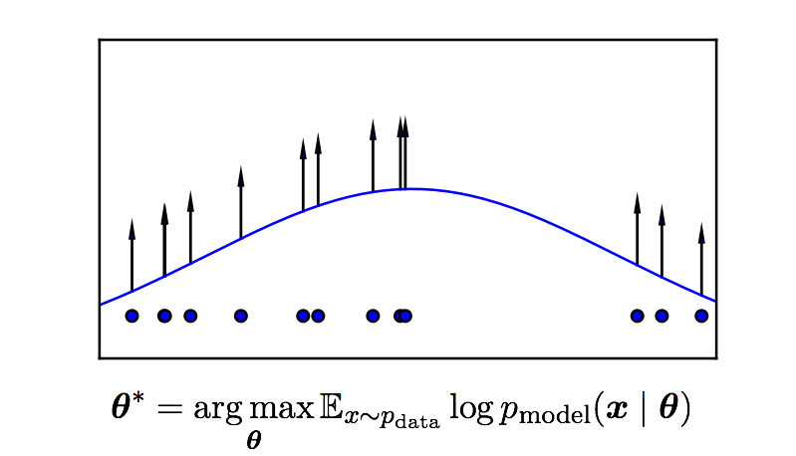
Maximum Likelihood Estimation
Goodfellow (2017)

Slide 8

Density function $Pr_{\text{model}}(x|θ)$
Explicit and analytical
e.g., Gaussian
can sample directly from model
Explicit and approximate
e.g., Boltzmann machine
can estimate probability by running Markov Chain Monte Carlo
Implicit
GAN
can’t estimate probability but can draw from distribution with given probability

Slide 9
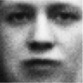
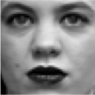
Adversarial Networks
real or fake?
Generative Model
Real world
Discriminative Model

Slide 10
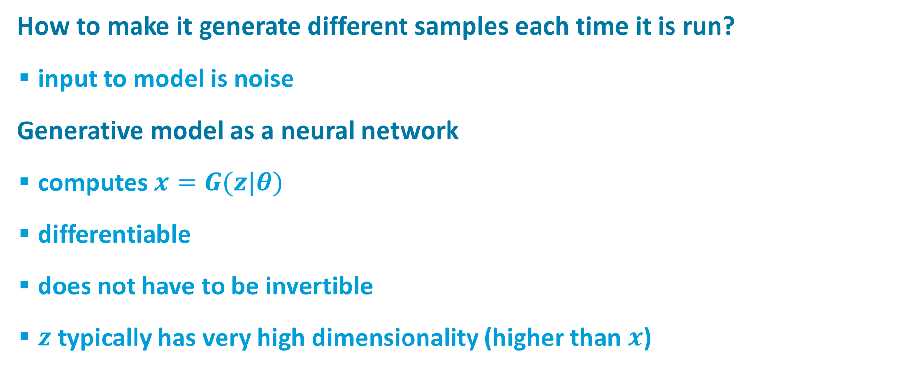

Generative Model
How to make it generate different samples each time it is run?
input to model is noise
Generative model as a neural network
computes $x=G(z|θ)$
differentiable
does not have to be invertible
$z$typically has very high dimensionality (higher than $x$)
noise ($z$)
Generative Model

Slide 11
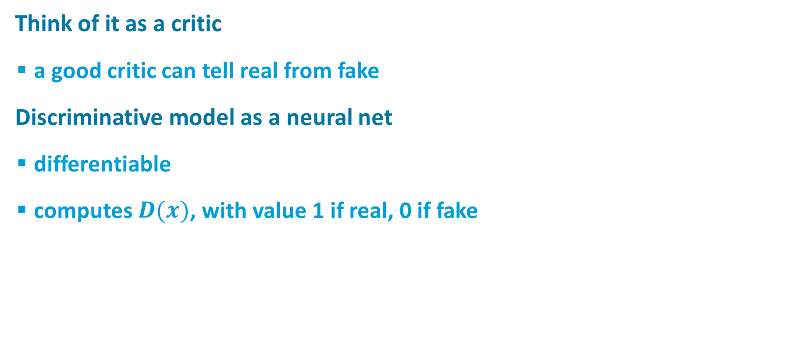
Discriminative Model
real or fake?
Think of it as a critic
a good critic can tell real from fake
Discriminative model as a neural net
differentiable
computes $D(x)$, with value 1 if real, 0 if fake
Discriminative Model

Slide 12

Training Procedure: Basic Idea
real or fake?
Discriminative Model
G tries to fool D
D tries not to be fooled
Models are trained simultaneously
As G gets better, D has a more challenging task
As D gets better, G has a more challenging task
Ultimately, we don’t care about the D
Its role is to force G to work harder
Real world
noise ($z$)
Generative Model

Slide 13
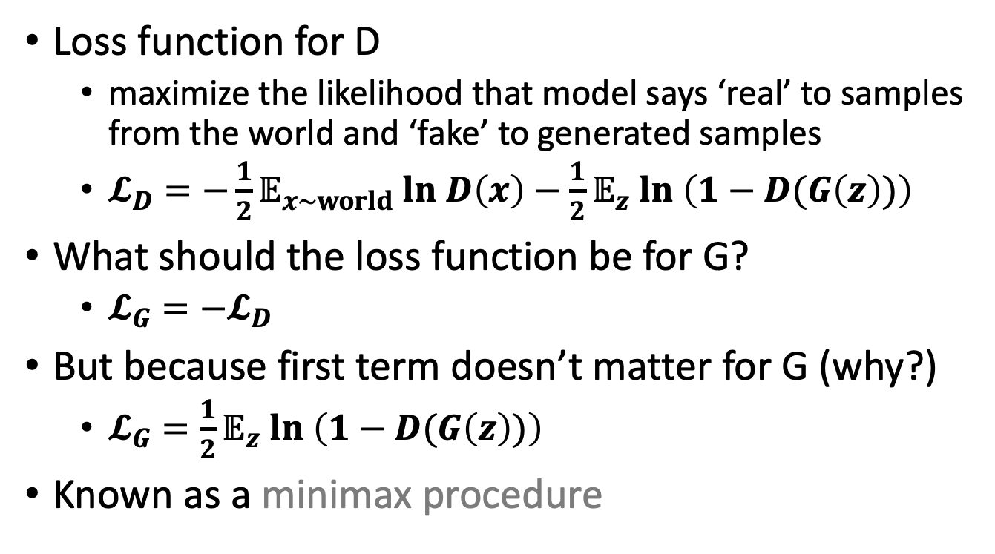
Loss Functions
real or fake?
Discriminative Model
Loss function for D
maximize the likelihood that model says ‘real’ to samples from the world and ‘fake’ to generated samples
$𝓛_{D}=−\frac{1}{2}𝔼_{x\sim world} ln D\left(x\right)−\frac{1}{2}𝔼_{z} ln \left(1−D(G\left(z\right))\right)$
What should the loss function be for G?
$𝓛_{G}=−𝓛_{D}$
But because first term doesn’t matter for G (why?)
$𝓛_{G}=\frac{1}{2}𝔼_{z} ln \left(1−D(G\left(z\right))\right)$
Known as a minimax procedure
Real world
noise ($z$)
Generative Model

Slide 14
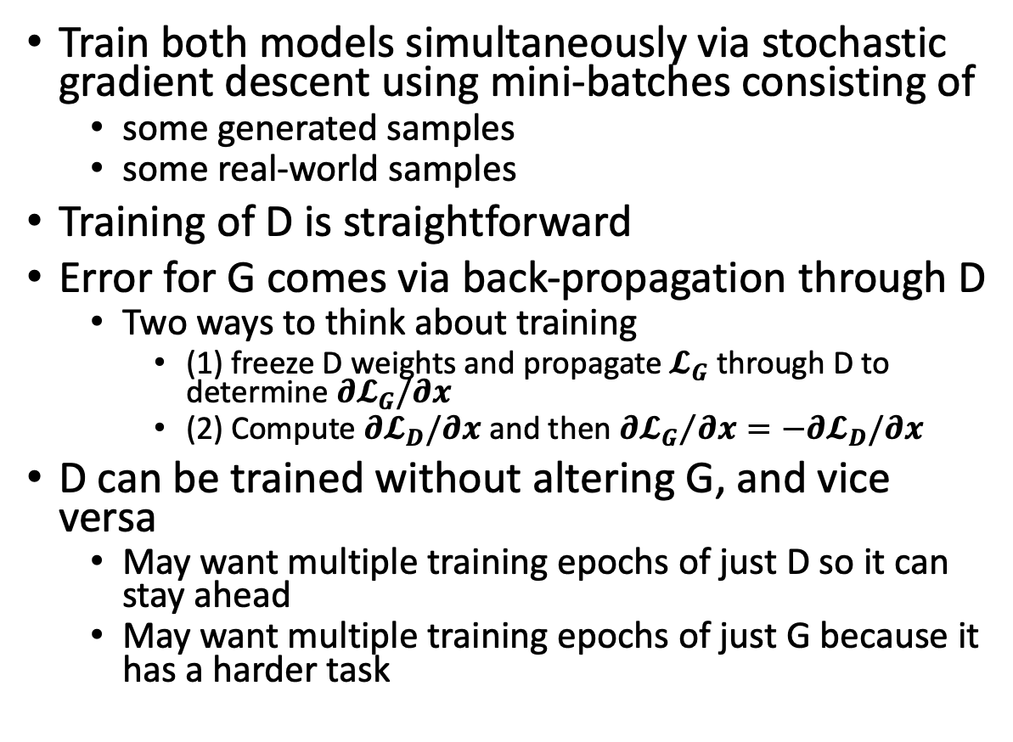
Training Procedure
real or fake?
Discriminative Model
Train both models simultaneously via stochastic gradient descent using mini-batches consisting of
some generated samples
some real-world samples
Training of D is straightforward
Error for G comes via back-propagation through D
Two ways to think about training
(1) freeze D weights and propagate$𝓛_{G}$ through D to determine $∂𝓛_{G}/∂x$
(2) Compute $∂𝓛_{D}/∂x$ and then ${∂𝓛_{G}}/{∂x}=−∂𝓛_{D}/∂x$
D can be trained without altering G, and vice versa
May want multiple training epochs of just D so it can stay ahead
May want multiple training epochs of just G because it has a harder task
Real world
noise ($z$)
Generative Model

Slide 15
Pseudo-code Implementation of GAN
Input: z, image, (label)
Network: D, G
Loss: D, G
Optimizer: D, G
Training:
for epoch
for batch
Update D
Update G

Slide 16
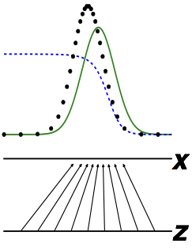
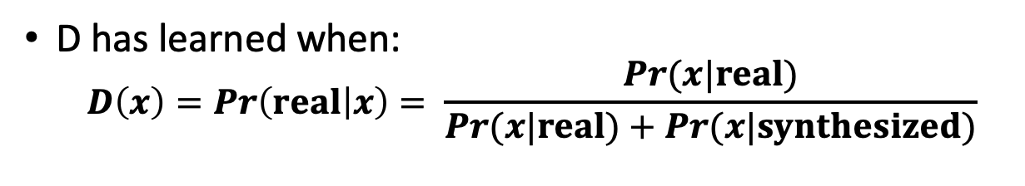
The Discriminator Has a Straightforward Task
real or fake?
D has learned when:
$$D\left(x\right)=Pr\left(real | x\right)= \frac{Pr(x|real)}{Pr(x|real)+Pr(x|synthesized)}$$
Discriminative Model
real
discriminator
model
Real world
noise ($z$)
Generative Model
Goodfellow (2017)

Slide 17
Three Reasons That It’s a Miracle GANs Work
real or fake?
G has a reinforcement learning task
it knows when it does good (i.e., fools D) but it is not given a supervised signal
reinforcement learning is hard
backprop through D provides G with a supervised signal; the better D is, the better this signal will be
Can’t describe optimum via a single loss
Will there be an equilibrium?
D is rarely fooled
but G still learns because it gets a gradient telling it how to change in order to do better the next round.
Discriminative Model
Real world
noise ($z$)
Generative Model

Slide 18
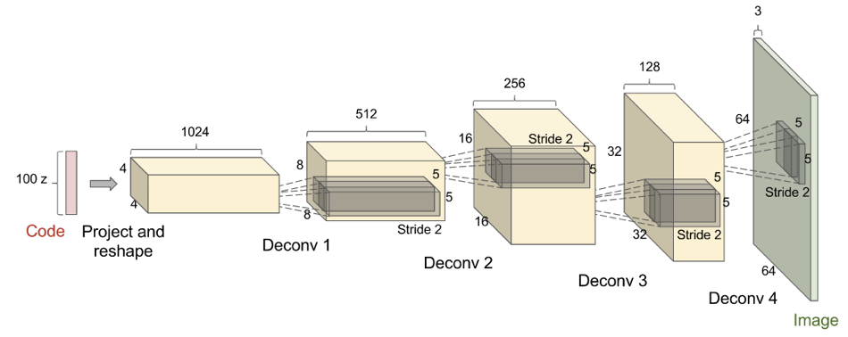
Deconvolutional GANs (DCGAN) (Radford et al., 2015)
Goodfellow (2017)
Batch normalization important here, apparently

Slide 19
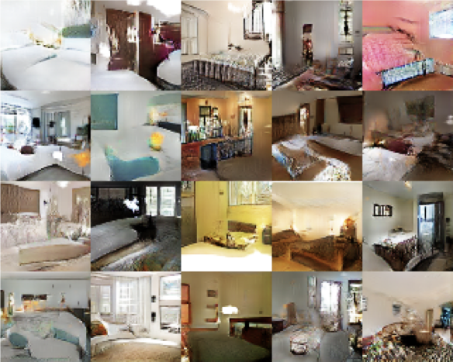
Deconvolutional GANs (DCGAN) (Radford et al., 2015)
Based on LSUN data set
10 scene categories
20 object categories
Goodfellow (2017)

Slide 20
Transposed Convolution (Deconvolution)
Stride=1
Pad=Valid
Stride=2
Pad=Valid
Stride=2
Pad=Same
Output
Conv
Input
Output
Deconv
Input
https://github.com/vdumoulin/conv_arithmetic

Slide 21
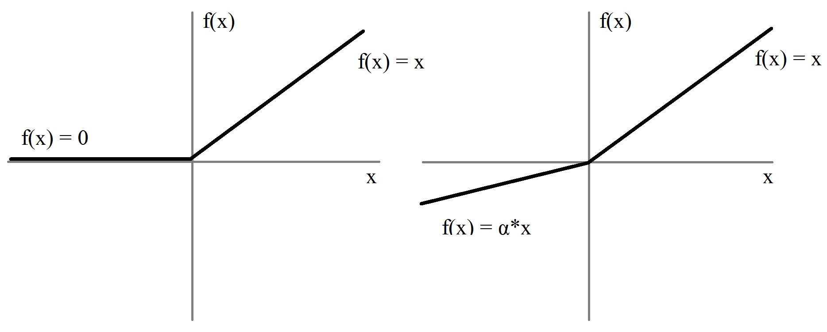
ReLU vs. Leaky ReLU
Used in Generator
Used in Discriminator

Slide 22
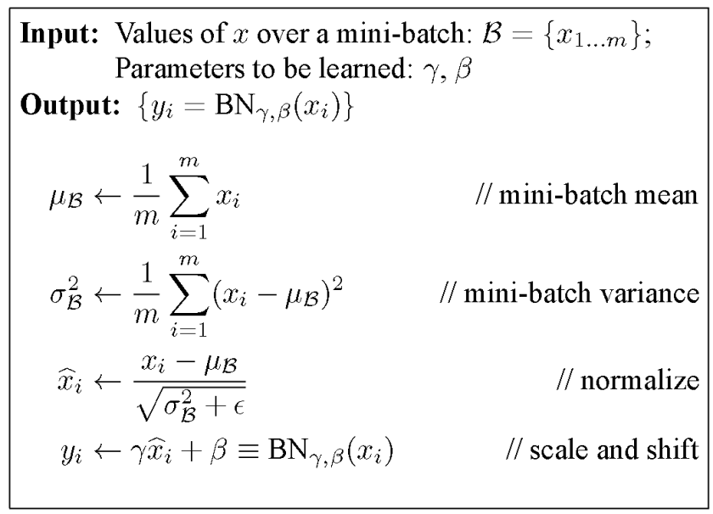
Batch Normalization (BN)
Saturation area
Zero gradient

Slide 23
Generative Adversarial Network (GAN)
Reshape,
FC, sigmoid
FC, BN, ReLU
Reshape
Conv (kernel 5x5, stride 2)
BN, LReLU (slope 0.2)
Deconv, tanh/sigmoid
Deconv (kernel 5x5, stride 2)
BN, ReLU
https://github.com/PramodShenoy/GANerations

Slide 24
GAN on MNIST
Deconv
Tanh/Sigmoid
Conv, BN,
LReLU
Conv, BN,
LReLU
Reshape,
FC, BN,
LReLU
FC,
Sigmoid
FC, BN,
Reshape
Deconv
BN, ReLU
100
7x7x16
14x14x8
28x28x1
14x14x8
7x7x16
256
1
Generator
Discriminator

Slide 25
Conditional GAN on MNIST
One-hot label
Deconv
Tanh/Sigmoid
Conv, BN,
ReLU
Conv, BN,
ReLU
Reshape,
FC, BN,
ReLU
FC,
Sigmoid
FC, BN,
Reshape
Deconv
BN, ReLU
100
7x7x16
14x14x8
28x28x1
14x14x8
7x7x16
256
1
Generator
Discriminator

Slide 26


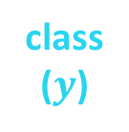
Using Labels Can Improve Generated Samples
Denton et al. (2015) Salimans et al. (2016)
real class 1
real class $n$
fake
noise ($z$)
Discriminative Model
Generative Model
class ($y$)
Notes:
GAN in lower right corner
LAPGAN next to it
6 classes from LSUN
Yellow circled images are closest real examples [to show it’s not just generating training data]

Slide 27
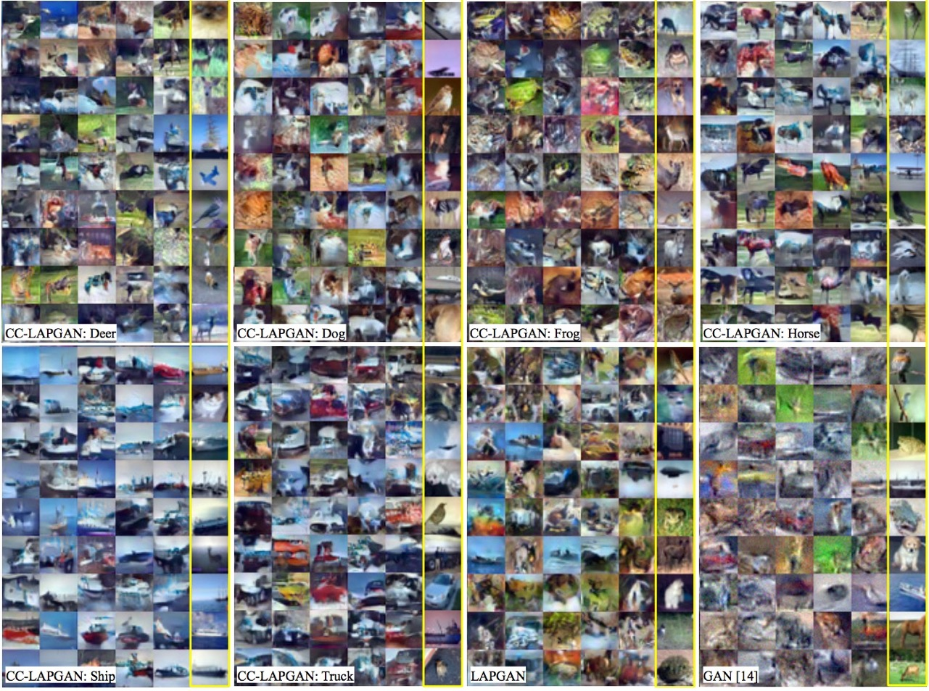
Using Labels Can Improve Generated Samples (Denton et al., 2015)
LAPGAN: multiresolution deconvolutional pyramid
CC-LAPGAN: class conditional LAPGAN
GAN: original Goodfellow model
Notes:
GAN in lower right corner
LAPGAN next to it
6 classes from LSUN
Yellow circled images are closest real examples [to show it’s not just generating training data]

Slide 28
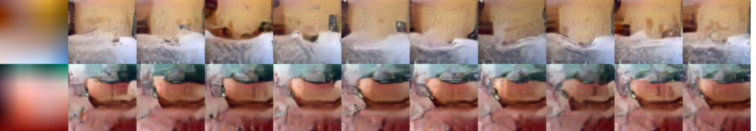
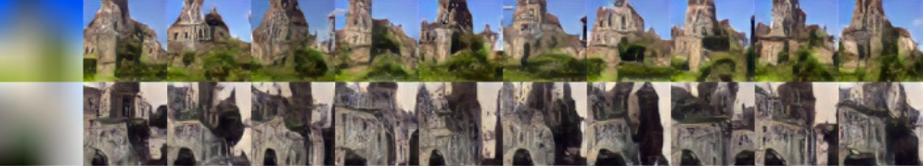
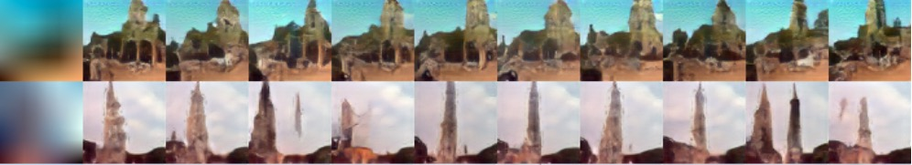
With Image Pyramid, Can Also Seed Generator With Low-Res Image + Class (Denton et al., 2015)
bedroom
church
tower
Notes:
columns are different draws

Slide 29
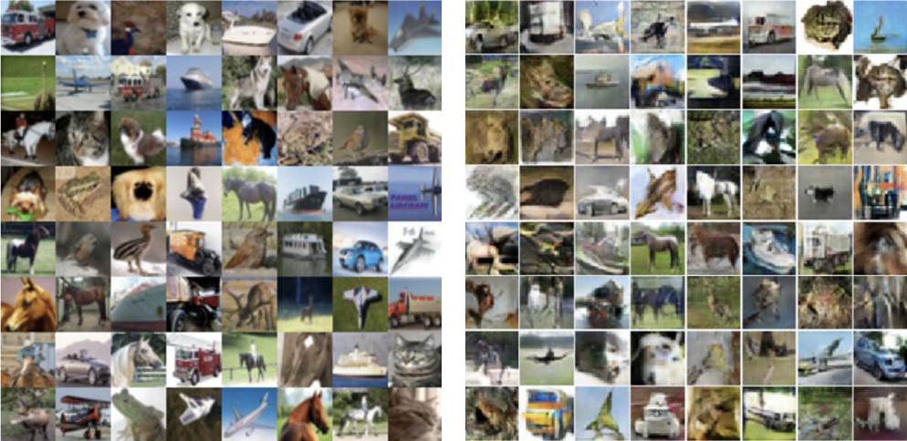
Schemes to Ensure Samples Are Diverse (Salimans et al., 2016)
Use nearest neighbor on latent representation to detect samples in a mini-batch that are too similar
CIFAR training images
Synthesized images

Slide 30
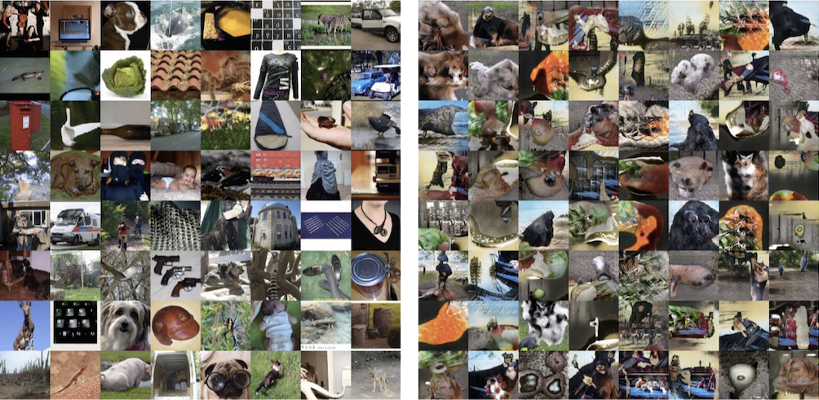
kjkjkj
ImageNet training images

Slide 31
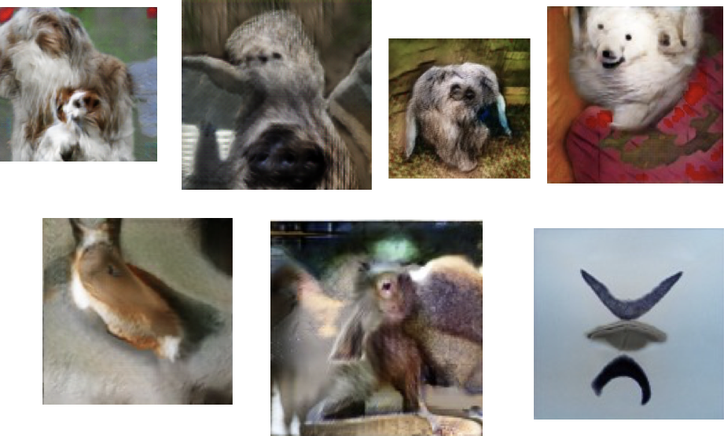
Cherry Picked Results
Goodfellow (2017)

Slide 32
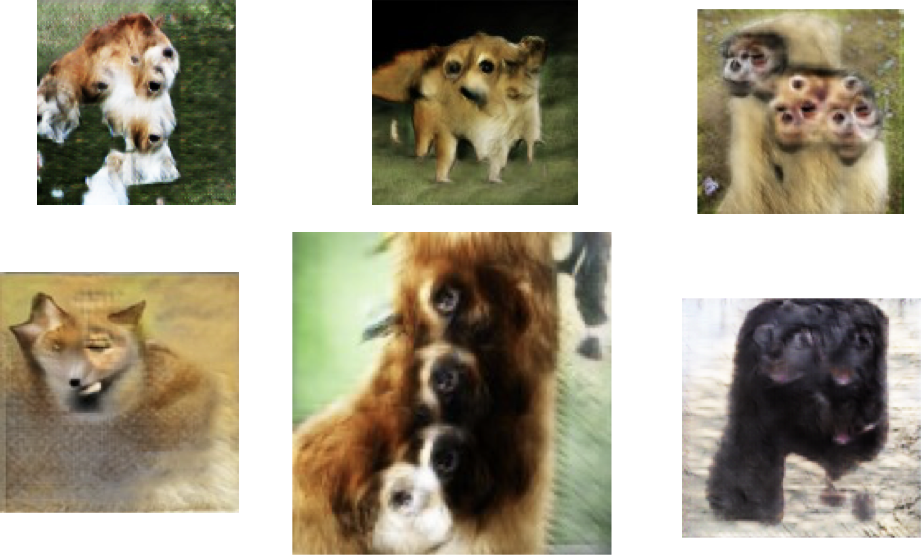
Problems With Counting
Goodfellow (2017)

Slide 33
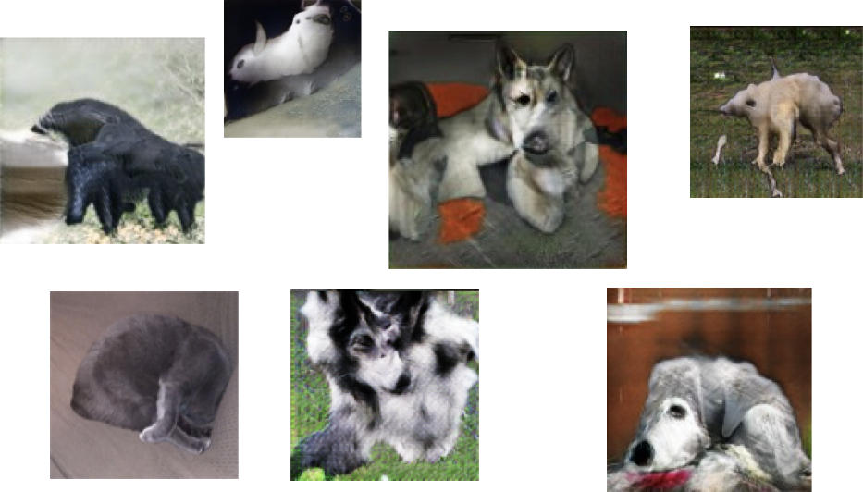
Problems With Perspective
Goodfellow (2017)

Slide 34
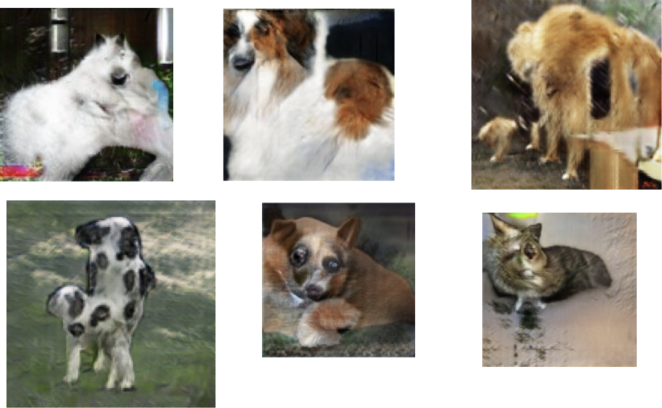
Problems With Global Structure
Goodfellow (2017)

Slide 35
Beyond Labels: Providing Images as Input to Generator: Next Video Frame Prediction (Lotter et al., 2016)
MSE tends to produce blurry images on any task
when you can’t predict well, predict the expectation
Notes:
Adversarial is sharper
What’s the architecture here? Generative model receives current frame as input (vs. random vector)

Slide 36
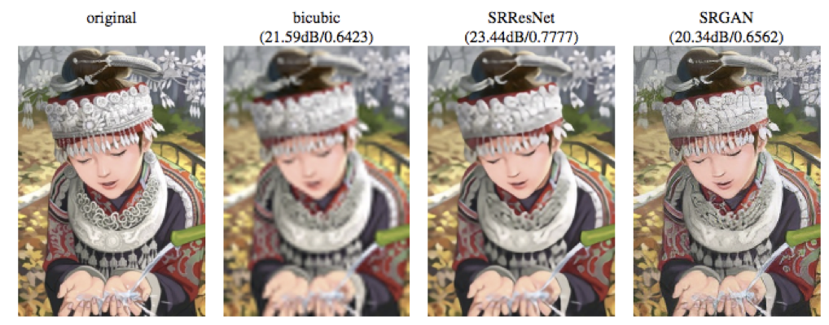
Beyond Labels: Providing Images as Input to Generator: Next Video Frame Prediction (Lotter et al., 2016)
Notes:
Generative model receives low res image as input

Slide 37
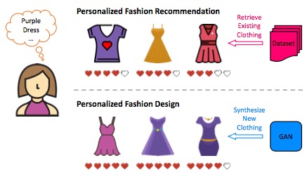
Visually-Aware Fashion Recommendation and Design With GANs (Kang et al., 2017)
Recommender systems predict how much a particular user will like a particular item
Can predict based on features of item (e.g., movie director, dress length)
Can also predict directly from images
Twist here is that instead of predicting from a predefined set, generate images that would be liked.

Slide 38
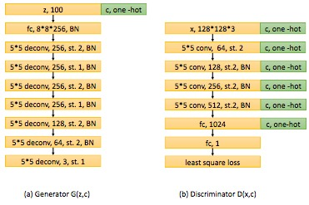
Visually-Aware Fashion Recommendation and Design With GANs (Kang et al., 2017)
Use class-conditional generator and discriminator

Slide 39
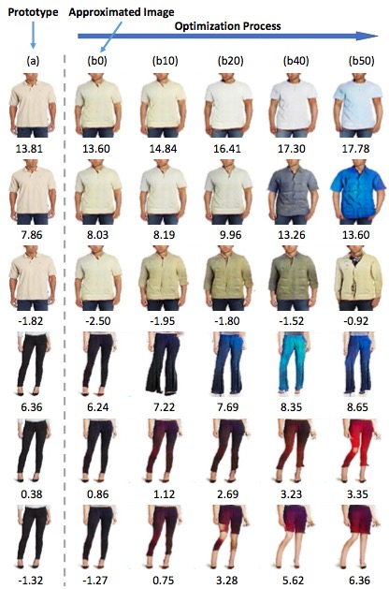

Visually-Aware Fashion Recommendation and Design With GANs (Kang et al., 2017)
Optimize with GAN
find latent representation $z$ that obtains the highest recommendation score
gradient ascent search

Slide 40
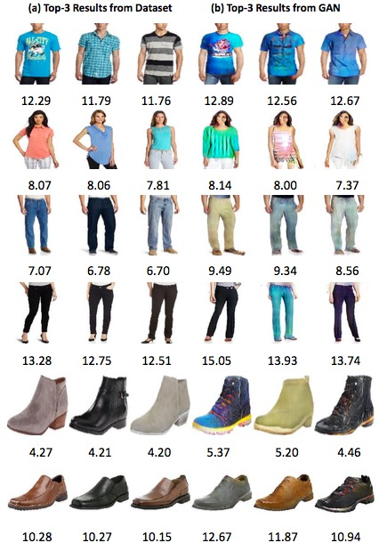

Slide 41
Cycle GAN

Slide 42
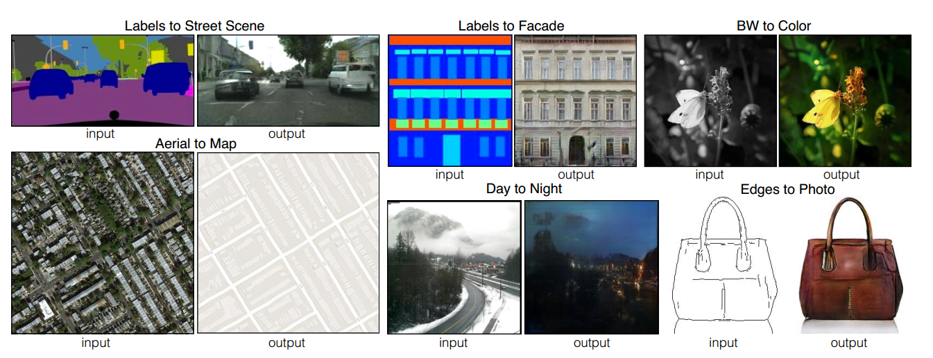
Image-to-Image Translation with pix2pix
Image-to-image Translation with Conditional Adversarial Nets
Phillip Isola, Jun-Yan Zhu, Tinghui Zhou, Alexei A. Efros. CVPR 2017

Slide 43
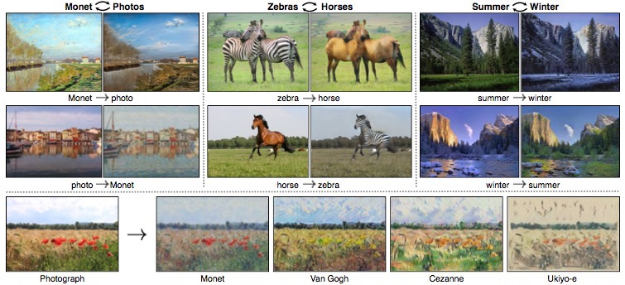
Cycle GANs [Zhu et al., ICCV 2017]
Given two image collections
algorithm learns to translate an image from one collection to the other
does not require correspondence between images

Slide 44



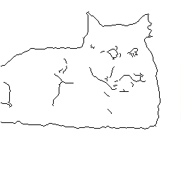
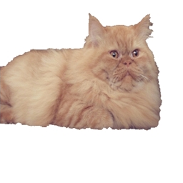


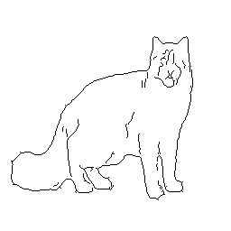
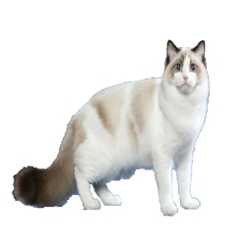
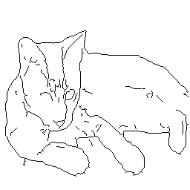
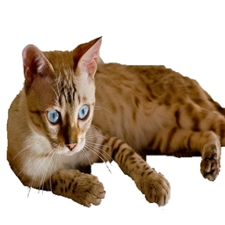
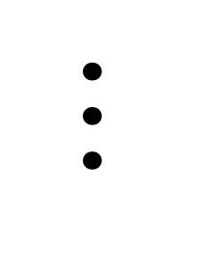
Paired
$$⋯$$

Slide 45
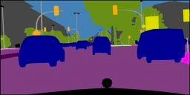
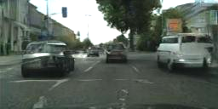
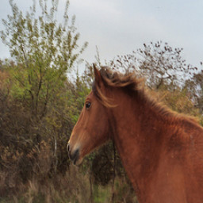

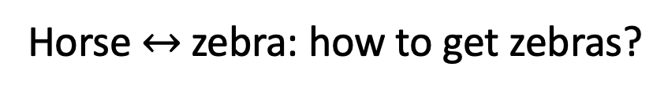
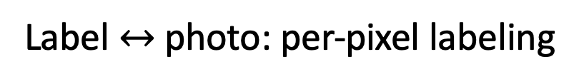
Paired
Label $↔$ photo: per-pixel labeling
Horse $↔$ zebra: how to get zebras?
- Expensive to collect pairs.
- Impossible in many scenarios.
$$⋯$$

Slide 46



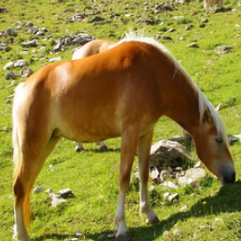





Paired
Unpaired
…
…
$$⋯$$

Slide 47



$$x$$
$$G(x)$$
$$G$$
Generator
$$D$$
No input-output pairs!

Slide 48

$$x$$
$$G(x)$$
$$G$$
$$D$$
Real!
Generator
Discriminator

Slide 49
$$x$$
$$G(x)$$
$$G$$
$$D$$
Real too!
Generator
Discriminator
GANs do not force output to correspond to input

Slide 50


mode collapse!

Slide 51







Cycle-Consistent Adversarial Networks
$$⋯$$
$$⋯$$
[Zhu*, Park*, Isola, and Efros, ICCV 2017]

Slide 52
Cycle-Consistent Adversarial Networks
$$⋯$$
$$⋯$$
[Zhu*, Park*, Isola, and Efros, ICCV 2017]

Slide 53














Cycle-Consistent Adversarial Networks
$$x$$
$$G(x)$$
$$F(G\left(x\right))$$
$$D_{Y}(G\left(x\right))$$
Reconstruction
error
$${\left\|F\left(G\left(x\right)\right)−x\right\|}_{1}$$
[Zhu*, Park*, Isola, and Efros, ICCV 2017]

Slide 54
Cycle Consistency Loss
Large cycle loss
Small cycle loss
$$x$$
$$G(x)$$
$$F(G\left(x\right))$$
$$D_{Y}(G\left(x\right))$$
Reconstruction
error
$${\left\|F\left(G\left(x\right)\right)−x\right\|}_{1}$$
[Zhu*, Park*, Isola, and Efros, ICCV 2017]

Slide 55










Cycle Consistency Loss
$$x$$
$$G(x)$$
$$F(G\left(x\right))$$
$$y$$
$$F(y)$$
$$G(F\left(x\right))$$
$$D_{Y}(G\left(x\right))$$
$$D_{X}(F\left(x\right))$$
Reconstruction
error
Reconstruction
error
$${\left\|F\left(G\left(x\right)\right)−x\right\|}_{1}$$
$${\left\|G\left(F\left(y\right)\right)−y\right\|}_{1}$$
See similar formulations [Yi et al. 2017], [Kim et al. 2017]
[Zhu*, Park*, Isola, and Efros, ICCV 2017]

Slide 56

Cycle Consistency in Vision
Consistent Track
Inconsistent Track
Forward-Backward Error: Automatic Detection of Tracking Failures. ICPR 10’
Zdenek Kalal, Krystian Mikolajczyk, and Jiri Matas.
Also see [Sundaram, Brox, Keutzer, ECCV 10’]

Slide 57





Cycle Consistency in Vision
Shape Matching
Co-segmentation
SfM
Huang et al, SGP’13
Wang et al, ICCV’13
Zach et al, CVPR’10
Collection Correspondence
Zhou et al, CVPR’15
Zhou et al, ICCV’15

Slide 58
Results

Slide 59





AMT ‘real vs fake’ test on maps $↔$ aerial
FCN scores on cityscapes labels$→$photos
Classification performance of photo$→$labels

Slide 60





Slide 61





Slide 62





Collection Style Transfer
Monet
Van Gogh
Photograph
@ Alexei Efros
Cezanne
Ukiyo-e

Slide 63




















Input
Monet
Van Gogh
Cezanne
Ukiyo-e

Slide 64



Monet’s paintings $→$ photos

Slide 65




Monet’s paintings $→$ photos

Slide 66









Slide 67
Why CycleGAN works

Slide 68



Style and Content Separation
Paired Separation
Unpaired Separation
Content
Adversarial Loss: change the style
Style
Cycle Consistency Loss: preserve the content
Separating Style and Content with
Bilinear Models
[Tenenbaum and Freeman 2000’]
Two empirical assumptions:
- content is easy to keep.
- style is easy to change.

Slide 69



Neural Style Transfer [Gatys et al. 2015]
Style and Content:
Content: feature difference
Style: Gram Matrix difference
Both losses are hard-coded

Slide 70
















Input
Style Image I
Style image II
Entire collection
CycleGAN
Photo $→$ Van Gogh
Input
Style image I
Style image II
Entire collection
CycleGAN
horse $→$ zebra

Slide 71


CycleGAN implementations
Torch
PyTorch
20+ implementations by researchers/developers:
Tensorflow, Chainer, mxnet, Lasagne, Keras…

Slide 72
Applications

Slide 73





CG2Real: GTA5 $→$ real streetview
GTA5 CG Input
Output
Inspired by [Johnson et al. 2011]

Slide 74


Real2CG: real streetview $→$ GTA
Cityscape Input
Output

Slide 75

Synthetic Data as Supervision
GTA5 images
Segmentation labels
[Richter*, Vineet* et al. 2016] [Krähenbühl et al. 2018]

Slide 76


Domain Adaptation with CycleGAN
Train on GTA5 data
Test on real images
 | meanIOU | Per-pixel accuracy
Oracle (Train and test on Real) | 60.3 | 93.1
Train on CG, test on Real | 17.9 | 54.0

Slide 77
Domain Adaptation with CycleGAN
GTA5 data + Domain adaptation
Test on real images
 | meanIOU | Per-pixel accuracy
Oracle (Train and test on Real) | 60.3 | 93.1
Train on CG, test on Real | 17.9 | 54.0
FCN in the wild [Previous SOTA] | 27.1 | -

Slide 78

Domain Adaptation with CycleGAN
Train on CycleGAN data
Test on real images
 | meanIOU | Per-pixel accuracy
Oracle (Train and test on Real) | 60.3 | 93.1
Train on CG, test on Real | 17.9 | 54.0
FCN in the wild [Previous SOTA] | 27.1 | -
Train on CycleGAN, test on Real | 34.8 | 82.8

Slide 79






Applications and Extentions
Attribute Editing [Lu et al.]
Object Editing [Liang et al.]
Low-res
Bald
Bangs
Mask
Input
Output
arXiv:1705.09966
arXiv:1708.00315
Front/Character Transfer [Ignatov et al.]
Data generation [Wang et al.]
Input
Output
samples by CycleWGAN
arXiv: 1801.08624
arXiv:1707.03124

Slide 80


Photo Enhancement
WESPE: Weakly Supervised Photo Enhancer for Digital Cameras. arxiv 1709.01118
Andrey Ignatov, Nikolay Kobyshev, Kenneth Vanhoey, Radu Timofte, Luc Van Gool

Slide 81

Image Dehazing
Cycle-Dehaze: Enhanced CycleGAN for Single Image Dehazing. CVPRW 2018
Deniz Engin∗ Anıl Genc∗, Hazım Kemal Ekenel

Slide 82
Failure cases

Slide 85




ImageNet
“Wild horse”

Slide 86


